Slide 1
Dear local leaders,
We’ve prepared this deck on Interaction Week 18 for you to communicate to your local communities.
Use those elements as you see fit and please reach out to us for questions or ask for missing elements.
We’ve put speaker notes to guide you through the slides.
Thank you for your help!
— last update May 6th 2017
Notes:
Speaker notes ;)

Slide 2


3—8 February 2018 • Lyon, FR
Notes:
Those are the dates of the entire Interaction Week 18.

Slide 3
Dissolving boundaries & building connections
3—8 February 2018 • Lyon, FR
Notes:
This is the theme of the main conference. More details here: http://interaction18.ixda.org/about.html

Slide 4
Week overview
Sat 3
Sun 4
Mon 5
Tue 6
Wed 7
Thu 8
Interaction Design Education Summit
Workshops
Interaction 18 conference
Field trips
Opening Night ✨
🥂 Awards ceremony & closing party
Local Leaders workshop
Student Design Challenge
Students awards
Notes:
This is week overview of what is happening and when during the 6 days.

Slide 5

Saturday 3 + Sunday 4
Grow your passion for learning and educating, explore how design learning is even more transdisciplinary.
edusummit.ixda.org
Notes:
The conference dedicated to the learning part of Interaction Design.

Slide 6
Interaction Workshops
Monday 5
Join the best designers and learn hands on.
interaction18.ixda.org

Slide 7

Monday 5 to Thursday 8
Demonstrate your skills in the design challenge and learn from amazing mentors.
sdc.ixda.org
Notes:
Reserved to students all around the world.
Spread the word in schools and during your local events!

Slide 8

At the Interaction Awards we will celebrate individuals and teams that through design leadership and innovation created impact and improved human lives.
awards.ixda.org
Notes:
Engage local design shops and consultancies
to participate in this ever growing award contest.

Slide 9
Tuesday 6 to Thursday 8
You will enjoy three full conference days, listening to experts and join conversations to reshape our changing relations with ourselves, our objects, the environment and the society as a whole.
interaction18.ixda.org
Notes:
The main event. Great speakers, fabulous audience
and some gorgeous venues coming your way!

Slide 10

Anticipated milestones
SEPTEMBER
Early bird tickets
Call for speaker open
NOVEMBER
Call for speaker closed
DECEMBER
Program announced
SEPTEMBER
Call for students open
NOVEMBER
Call for students closed
DECEMBER
Finalists announced
MAY
Call for projects open
SEPTEMBER
Call for projects closed
NOVEMBER
Shortlist announced
JANUARY
Finalists announced
People choice's vote open
JUNE
Call for speaker open
JULY 1ST
General selling
SEPTEMBER 13TH
Call for speaker closed
OCTOBER
Workshops announced
+ early bird tickets
NOVEMBER
Program announced
DECEMBER
Workshops general selling
Notes:
Some key dates if you need to communicate
details the initiatives and events.

Slide 11
First Two Keynotes
Notes:
Some slides showcasing the beauty of the city of Lyon,
proofs of the genuine French flavor added to this IxDA annual event.

Slide 12
Anab Jain imagines the future for living with her vanguard laboratory, design and film studio Superflux. She inspires and challenges us to look critically at decisions and choices we make, showing us how design can drive powerful insights.
Alan Cooper, “Father of Visual Basic”, author and co-founder of Cooper, he has dedicated decades to the crossroad of design and development, humanizing technology through his groundbreaking work in software design.
Notes:
Some key dates if you need to communicate
details the initiatives and events.

Slide 13
“La Sucrière” Main conference venue
Notes:
Some slides showcasing the beauty of the city of Lyon,
proofs of the genuine French flavor added to this IxDA annual event.

Slide 14
Notes:
La Sucrière — Main conference venue
You will join us at La Sucrière, an old sugar warehouse. La Sucrière still preserves the industrial charm of its origins, with strong structural pillars, concrete beams, and sugar feed chutes, not to mention the massive silos on its side.
Its wooden rooftop, hosting Le Sucre, a hip bar and a venue for famous DJs, will provide you a wonderful view of the rivers from its massive terrace.

Slide 15
A bit about Lyon…
Notes:
Some slides showcasing the beauty of the city of Lyon,
proofs of the genuine French flavor added to this IxDA annual event.

Slide 16
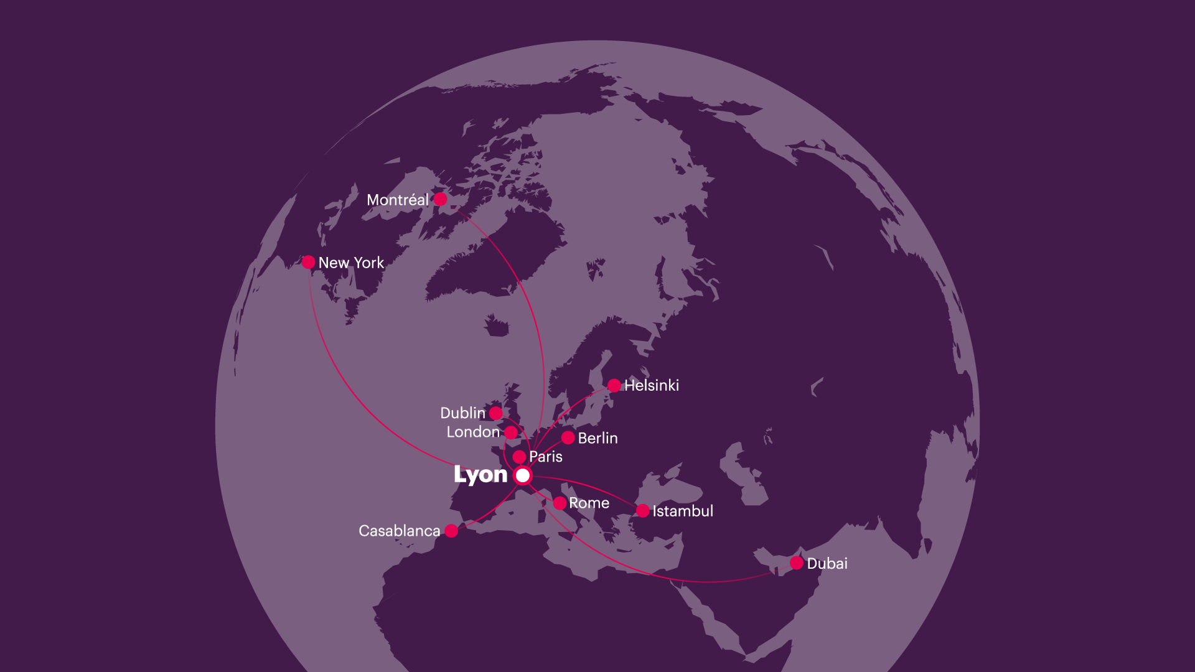
Notes:
Coming to Lyon is easy!

Slide 17
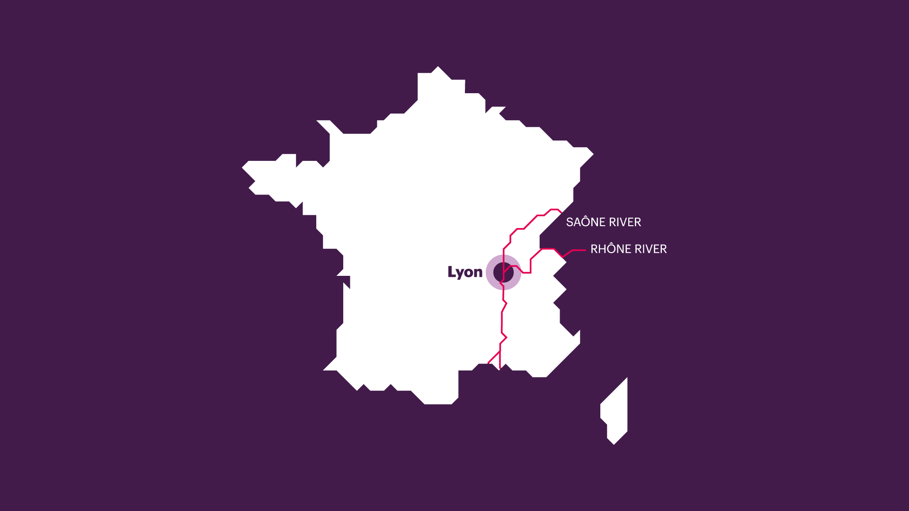
Notes:
Lyon is located at the heart of France, where two rivers meet.
Only 100 minutes away from Paris by train.

Slide 18
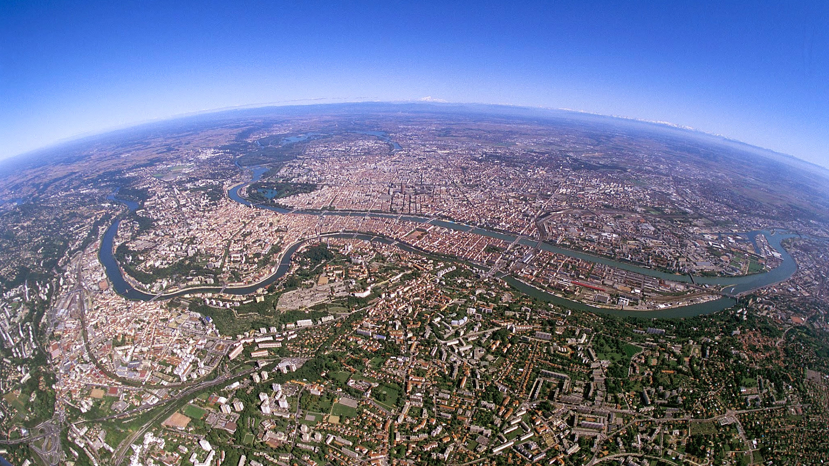
Photo Aderly — © Brice Robert
Notes:
Lyon from above, a 1 million people urban area, with various landscapes.
You can see the confluence happening on the right part of the picture
(where the Saône river meets the Rhône river).

Slide 19
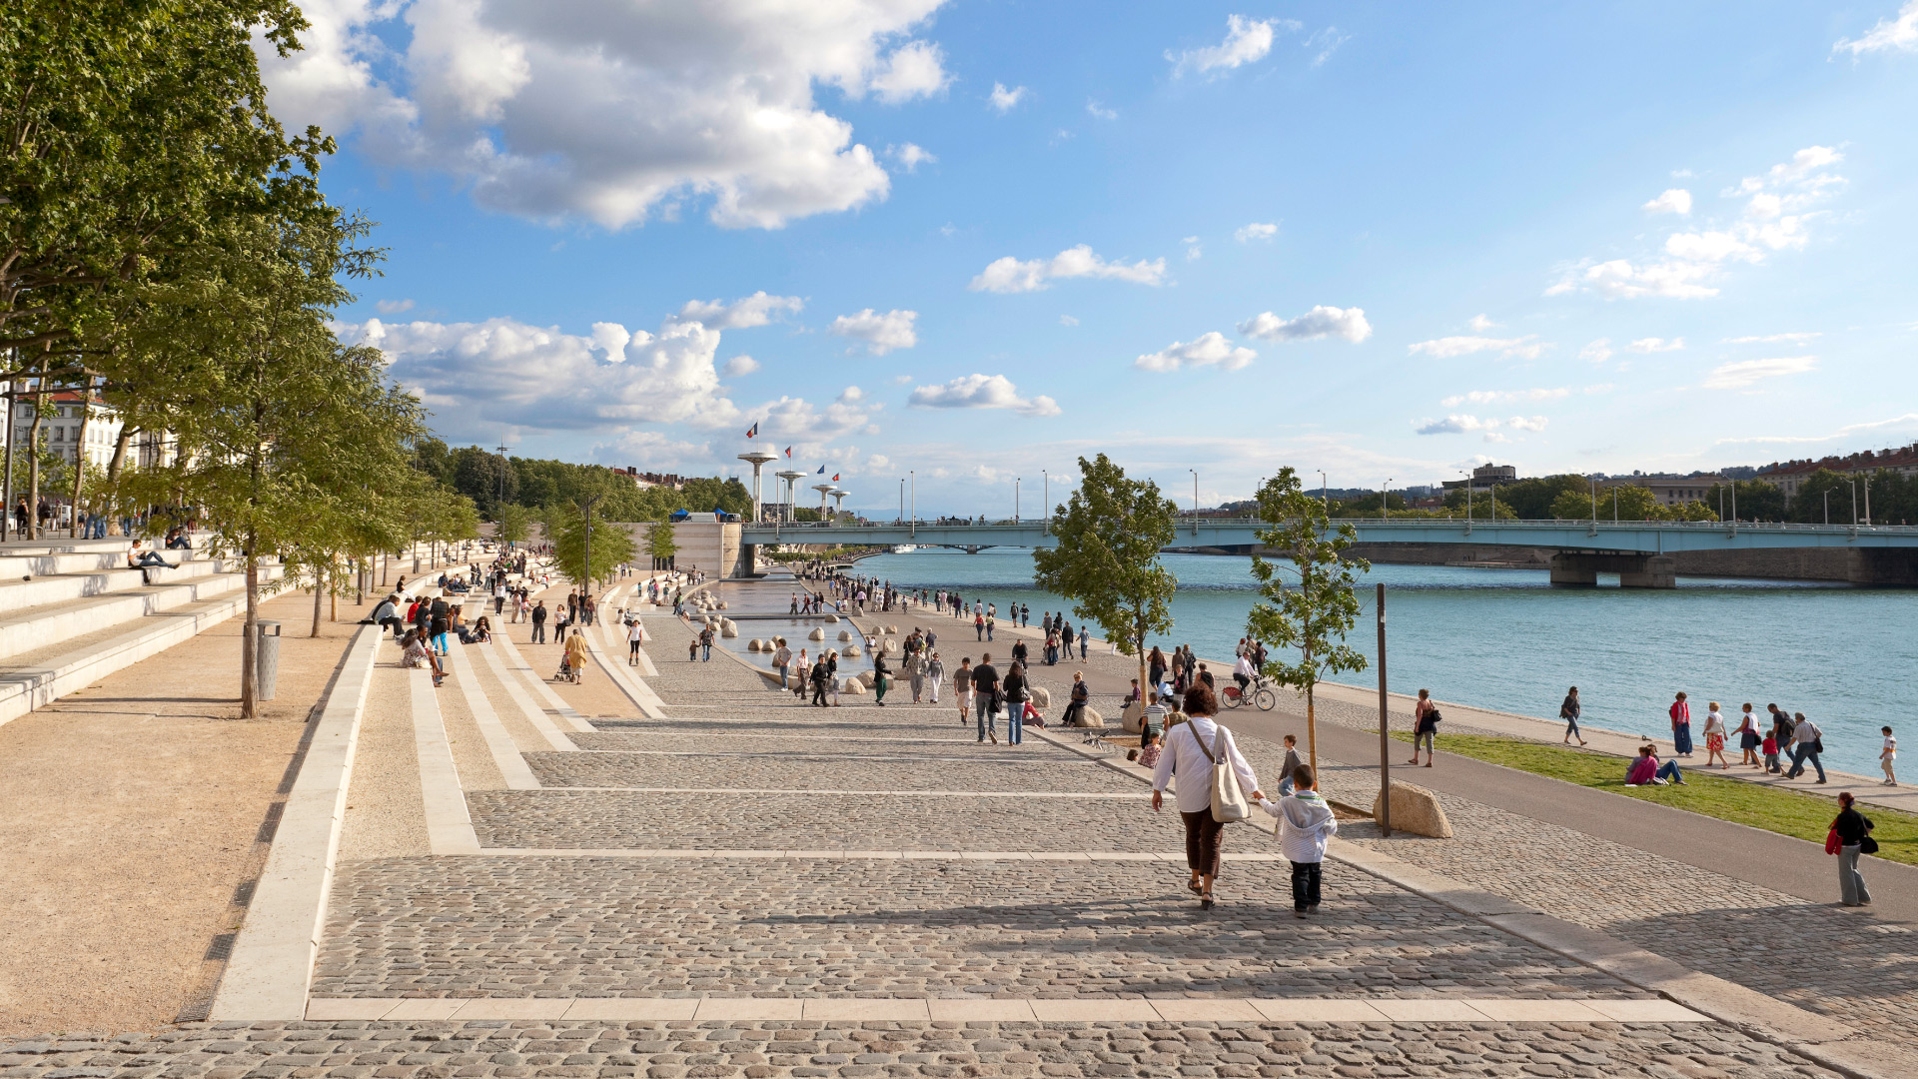
Photo Aderly — © Brice Robert
Notes:
The Rhône river banks, for pedestrians & bikes.

Slide 20
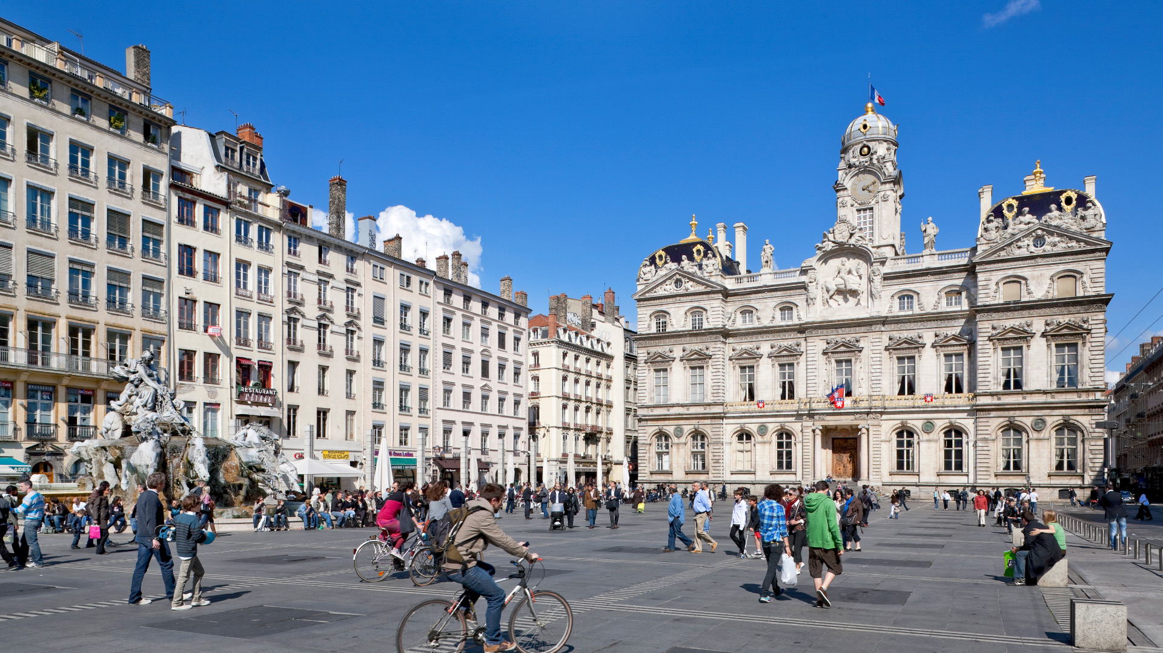
Photo Aderly — © Brice Robert
Notes:
Lyon cityhall.

Slide 21
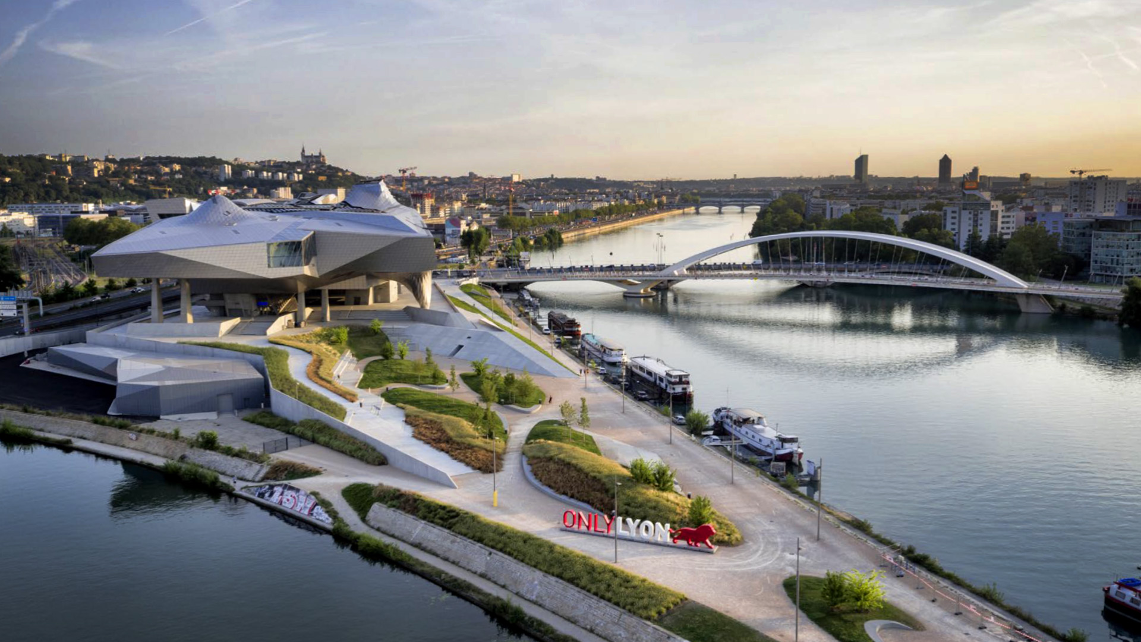
Photo © Musée des Confluences
Notes:
Confluence district. Confluences museum at the forefront,
the Rhône river on the right and Lyon cityscape on the horizon.

Slide 22
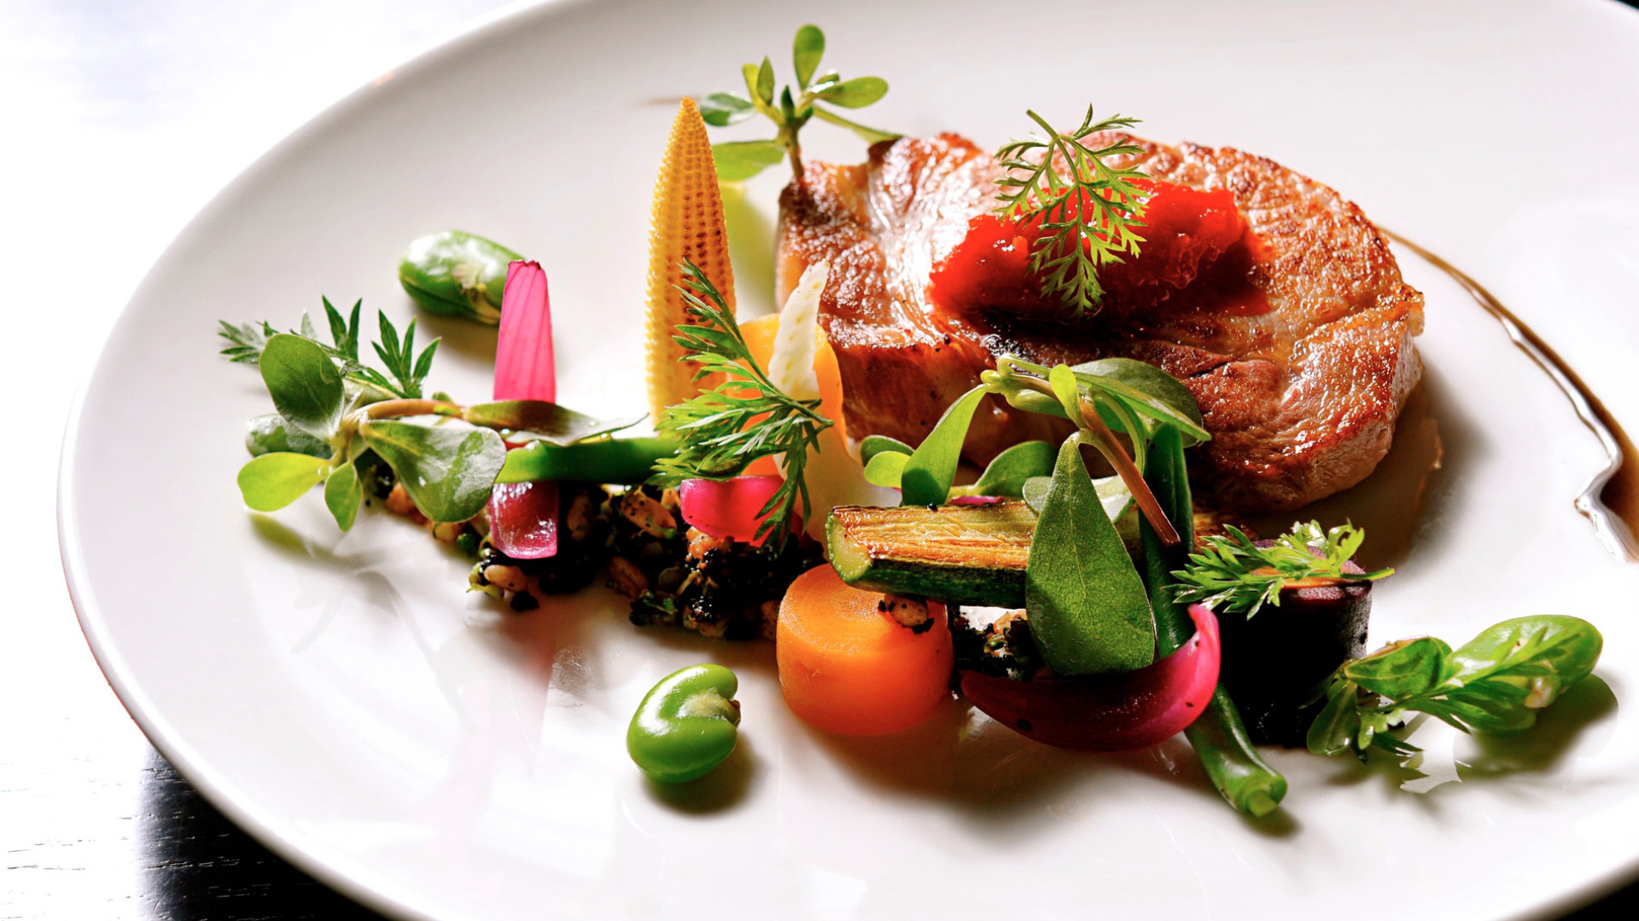
Photo © Au 14 février Vieux Lyon
Notes:
Lyon is considered as the French gastronomy capital,
come and experience the French cuisine at its finest…

Slide 23

Interaction 18 teaser video
vimeo.com/202684890
Notes:
You can show the teaser video that was introduced
during Interaction 17 in New York.

Slide 24
See you in Lyon!
interaction18.ixda.org
Notes:
Voilà, thank you again.
“Merci beaucoup.”

